Slide 1
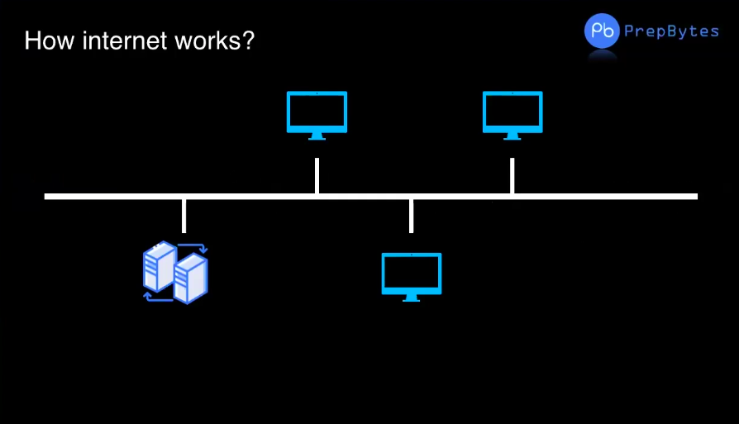

Slide 2
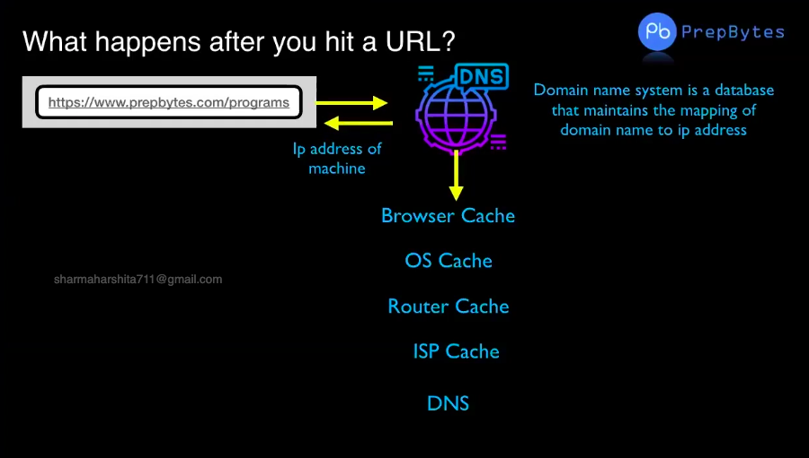

Slide 3
The function of DNS server is resolving (translating) human-readable domain names(facebook.com) to corresponding numeric Internet Protocol (IP) addresses . Ex: www.prepbytes.com → 93.184.216.34 The Domain Name System (DNS) is the phonebook of the Internet. DNS is responsible for finding the correct IP Addresses for domains.(like google.com, prepbytes.com etc..).
What is DNS?

Slide 4
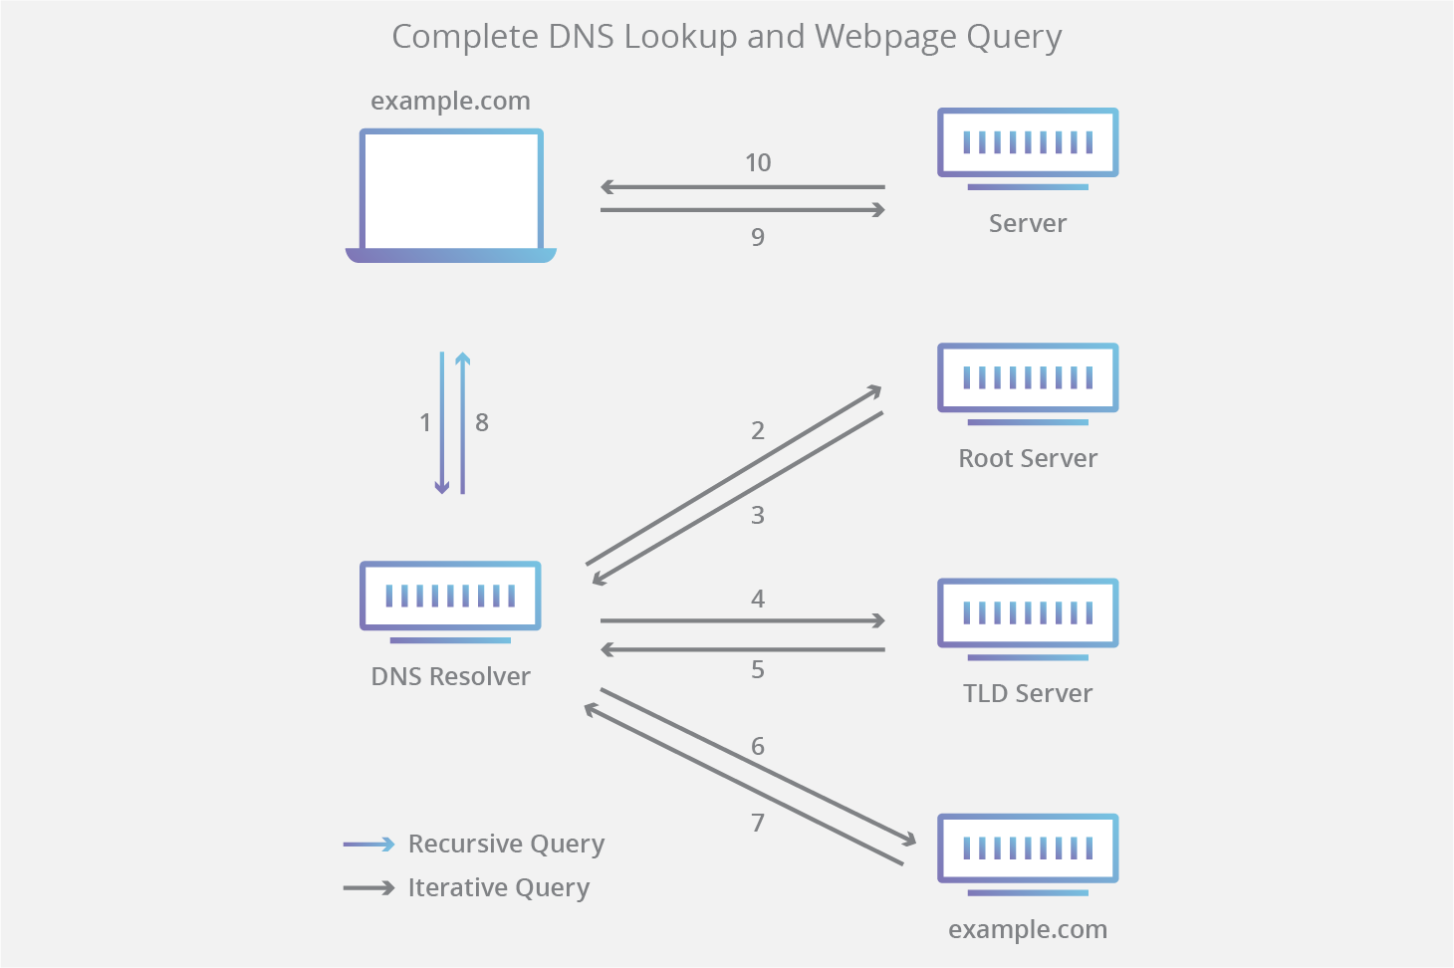

Slide 5
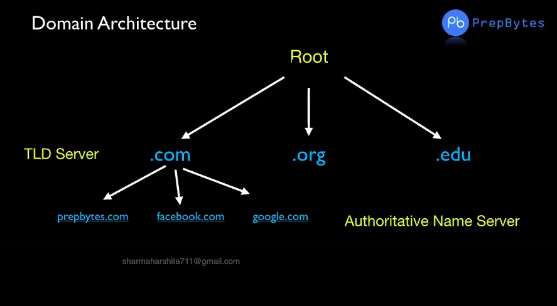

Slide 6
→ At first the DNS resolver(aka. DNS recursor) receives query from the DNS client , then interacts with other DNS servers to hunt down the correct IP Address. → After receiving request the resolver actually behaves like a client itself., then it requests root nameserver. → Root server is the first step in resolving human readable domains into IP addresses. → The root server then responds to the resolver with the address of a top-level Domain(TLD) DNS server (such as .com or .net) that stores the information for its domains. → Next the resolver queries the TLD server. The TLD server responds with the IP address of the domain’s authoritative nameserver. The recursor then queries the authoritative nameserver, which will respond with the IP address of the origin server. → The resolver finally pass the origin server IP address back to the DNS client .Now using this IP address the client can intiate a query directly to the origin server(examole.com) .th the IP address of the origin server.
TLD Name Server and Authoritative Name Server

Slide 7
Working of DNS: Let client requested for www.prepbytes.com →The request will be sent to DNS Resolver. →Resolver now acts like a client and requests Root server. →Root server will check the top level domain in the request (.com, .org etc..) and sends the address of corresponding TLD (top-level domain) server. In this case it is .com . →Now the TLD server responds with the authoritative name server. Now the DNS server requests the corresponding authoritative server , this authoritative server finally responds with the origin server.

Slide 8
How websites Work?
→ Frontend – Frontend is everything user can see and interact with.
→ Frontend of website is accessible through the browser
→ Backend – Backend consists of a backend application and database. Application.
→ Helps us interact with database, 3rd party APIs and backend is where lots of business.
→ Logic and algorithms are written.

Slide 9
→ To build a frontend application we use HTML, CSS , JavaScript. → Backend application can be build using many languages. Ex: Nodejs( javaScript), Java , C#, python etc..

Slide 10
Login Example
Person enters email id / pwd using Frontend
Frontend sends login id pwd to backend to check if it is correct
Backend interacts with database and finds out if login id /pwd is correct
Frontend logins the user or shows msg of incorrect creds
Backend sends information back to frontend

Slide 11
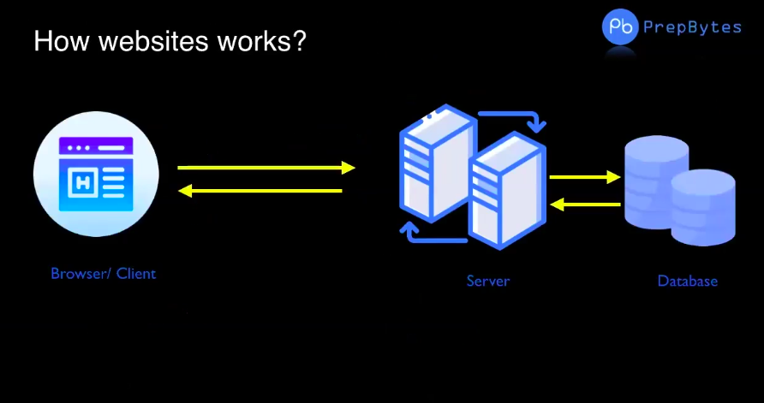

Slide 12
Opportunities in Web development: →There are job opportunities aplenty. → Roles for a web developer i) Front-end developer. ii) Back-end developer. iii) Full stack engineer. iv) Software engineer. v) senior web developer. Ofcourse.. You can start your own company as well.

Slide 13
HTML

Slide 14
Content
What is HTML?
HTML Tag
HTML Boilerplate
Box Model
Texts in HTML
Lists
Images
Forms
Table
Iframes
Videos
Div and span

Slide 15

Introduction to HTML

Slide 16
Key Shortcuts :
Ctrl + C → copy the selected content.
Ctrl + V → Pasting.
Ctrl + A → select all the content in a file.
Ctrl + Z → Undo.
Ctrl + X → Cut .

Slide 17
What is HTML ?
HTML stands for Hyper Text Markup Language.
HTML is the standard markup language for creating Web pages.
HTML describes the structure of a Web page.
HTML consists of a series of elements.
HTML elements tell the browser how to display the content

Slide 18
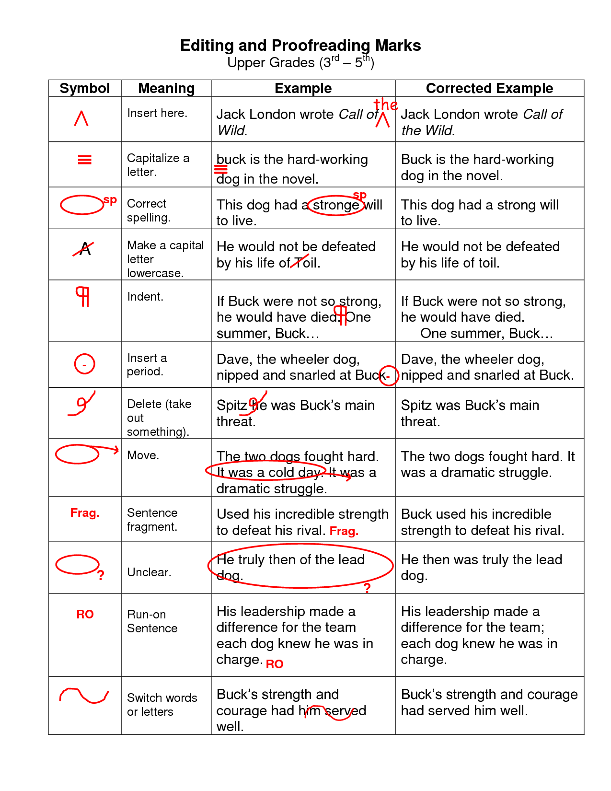

Slide 19
HTML TAGS:
HTML tags are predefined keywords which defines how web browser will format and display content.
Ex: <b>bold words</b>
All HTML tags are must be enclosed within angular brackets (< & >) .
Ex: <html>, <head> etc..
Most of the HTML tags will have both opening and closing tags , very few tags will have only opening tags.
Ex: 1) <html> </html>
2) <div> </div>
3) <hr> (only opening tag)
4) <br> (only opening tag)

Slide 20
HTML Tags Examples
<h1>PrepBytes</h1>
<p>Hi I am doing great</p>
<a href=“https://www.prepbytes.com”>PrepBytes</p>

Slide 21
Some frequently used tags:
<html></html> ( Root tag).
<head></head> (head tag contains metadata of the webpage).
<body></body> (Contains body of the webpage).
<h1></h1> ( Heading tag)
<div></div> ( used to make divisions of content in the webpage)
<p></p> (paragraph tag)
<b></b> (bold tag)
<a></a> (anchor tag)
<img > (image tag)
<hr> (Horizontal Rule)
<br> (Line break)
<form></form> ( To create forms)
The above are frequently used tags , but there are many(132 tags as of now) more tags are there.

Slide 22
HTML Tags
attribute
attribute value
Content
Closing tag
<a href=“index.html”>Index</a>
Element
HTML tags and attributes are case insensitive Attribute values are case sensitive

Slide 23
Attributes:
HTML attributes provide additional information about HTML elements.
Ex: <img src=“image_url” >
Attributes are always specified within the start tag .
Ex: <a href=“url” >click </a> .
There can be multiple attributes for a single HTML elements .
Ex: <input name=“aravind” placeholder=“Username” >

Slide 24
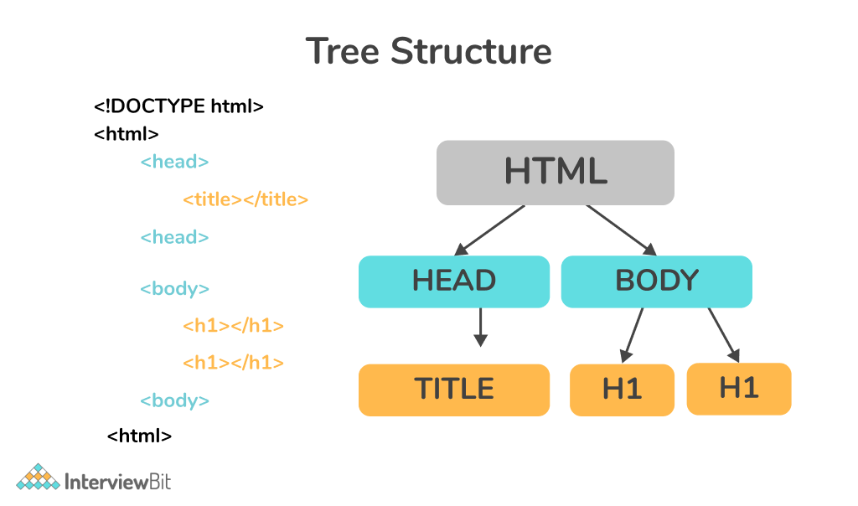
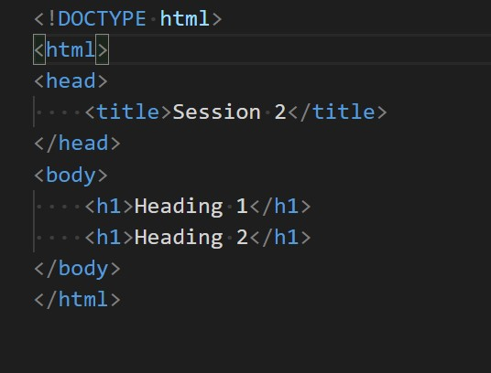
HTML Structure:

Slide 25
Explanation For Above Sample Document
The <!DOCTYPE html> declaration defines that this document is an HTML5 document
The <html> element is the root element of an HTML page
The <head> element contains meta information about the HTML page
The <title> element specifies a title for the HTML page (which is shown in the browser's title bar or in the page's tab)
The <body> element defines the document's body, and is a container for all the visible contents, such as headings, paragraphs, images, hyperlinks, tables, lists, etc.
The <h1> element defines a main heading
The <p> element defines a paragraph

Slide 26
Head tag :
Content inside the head tag will not be displayed in the browser.
Head tag contains metadata (data about page).
→The following tags can go inside head tag.
<title> <link>
<script> <meta>
<base> <noscript>
→ <title> is used to declare the title of the webpage .
→ <base> is used for default URL.
→ <meta> is used for defining metadata(information about webpage) of the webpage.

Slide 27
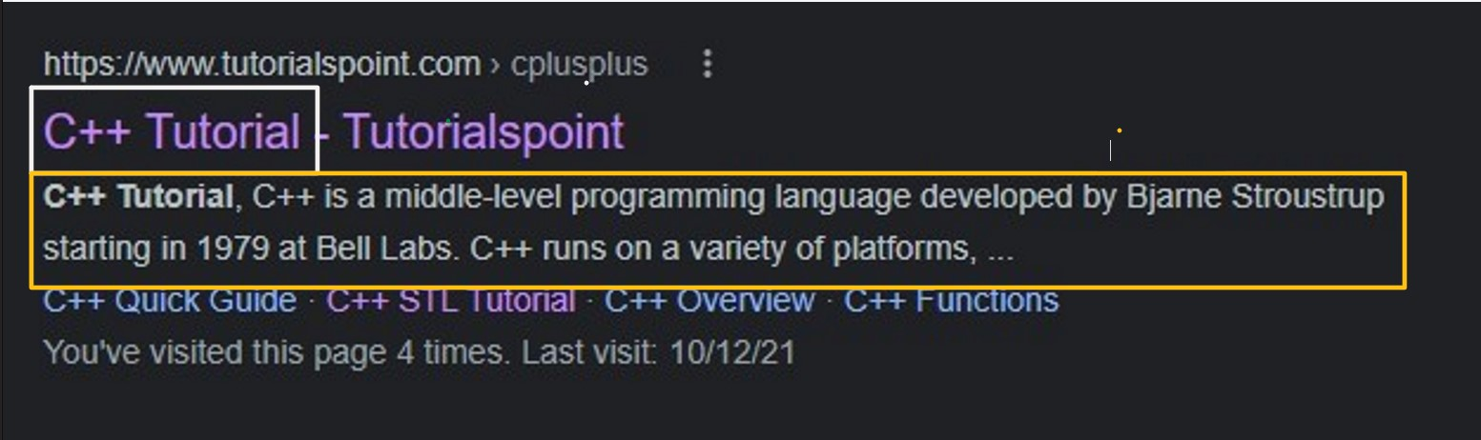
Meta Tag :
<!DOCTYPE html>
<html>
<head>
<title>C++ Tutorial</title>
<meta name="dn" content="C++ Tutorial, C++ is a middle-level programming escriptiolanguage developed by Bjarne ...."/>
</head>
<body>
</body>
</html>
White color box is the title of the webpage.
Yellow color box is the description of the webpage.

Slide 28
HTML Headings
Html headings are used to define the structure of the web page.
Html offers six different headings tags h1, h2, h3, h4, h5, and h6.
h1 tag mostly used for important headings like title (title of the content not the title of webpage), and h6 used for the least important headings.
The heading is a block-level HTML element which means that it will always start from a new line. The heading element in Html has both a starting tag and an ending tag.
<h1>This is an HTML heading.</h1>

Slide 29
Html tag Rank Default size (in Px)
<h1><h1> 1 32
<h2><h2> 2 24
<h3><h3> 3 18
<h4><h4> 4 16
<h5><h5> 5 13
<h6><h6> 6 10

Slide 30
Heading sample Document
<!DOCTYPE html>
<html>
<head>
<title>Headings In Html</title>
</head>
<body>
<h1>This is h1 tag</h1>
<h2>This is h2 tag</h2>
<h3>This is h3 tag</h3>
<h4>This is h4 tag</h4>
<h5>This is h5 tag</h5>
<h6>This is h6 tag</h6>
</body>
</html>

Slide 31
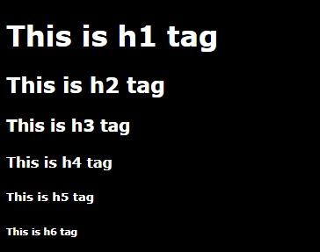
Output For Heading Sample Document

Slide 32
HTML Headings
It is recommended to have one H1 heading – just like you have only one title of the book
It is recommended not to use headings just for font size purpose, as we can manage font size using css as well
You should use heading in sequence like h1 and then h2 and so on

Slide 33
Exercise
Try all h1 tags

Slide 34
Paragraph Tag
The p element represents a paragraph in an HTML document .
It is a block-level HTML element which means that it will always start from a new line. When we create an HTML paragraph browser always creates white space before and after the paragraph.
The p element in html has both a starting tag <p> and an ending tag </p>. All the content of a paragraph is placed between the starting tag and ending tag.
In Html The paragraph is marked as:
<p>This is a paragraph.</P>

Slide 35

<!DOCTYPE html>
<html>
<head>
<title>HTML paragraph</title>
</head>
<body>
<p>This is Paragraph,which will start on new line</</p>
</body>
</html>
Paragraph sample Document
Output For Paragraph sample Document

Slide 36
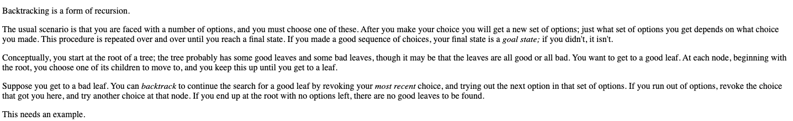
Student Exercise
Replicate first four paragraphs of this site: https://www.cis.upenn.edu/~matuszek/cit594-2012/Pages/backtracking.html

Slide 37
Text Formatting:
em vs I : em used for emphasized text , i used for italic text.
strong vs bold : Used to make text bold strong is used for important text, whereas bold is used for just making the text bold.
sub vs sup : For subscript and superscript.
ins vs del : ins used for underlined text , del is used for strikethrough the text.
Mark : Used to mark/Highlight some text .
Small : Defines smaller text.

Slide 38
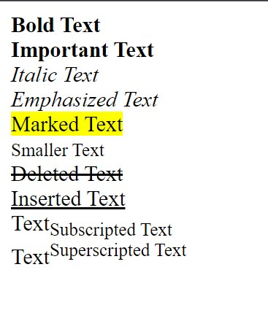
Text formatting :
<!DOCTYPE html>
<html>
<head>
<meta charset="UTF-8">
<title>Aravind</title>
</head>
<body>
<b>Bold Text</b><br>
<strong>Important Text</strong><br>
<i>Italic Text</i><br>
<em>Emphasized Text</em><br>
<mark>Marked Text</mark><br>
<small>Smaller Text</small><br>
<del>Deleted Text</del><br>
<ins>Inserted Text</ins><br>
Text<sub>Subscripted Text</sub><br>
Text<sup>Superscripted Text</sup><br>
</body>
</html>

Slide 39
HTML paragraph</
Anchor Tag(Known as Heart of HTML)
An anchor tag is a HTML element that creates a link to a target URL. When correctly implemented, the link can wrap around text, images, or as buttons, so that users can interact with it and visit the link's destination.
<a href="https://www.google.com">Google Home</a>
Opening Tag
Attribute Value
Attribute
anchor text
Closing Tag
It will display Google Home text with underline of blue colour and on opening it it will redirect to the Google with in same Page

Slide 40
HTML paragraph</
Exercise
1) Write a text PrepBytes and on click of the text it should redirect to prepbytes website
Create two html files index1 and index2, create link between 2 files.

Slide 41
Image Tag :
<img src="./tp/image.jpg" alt="Random Image" width="400" height="300">
→ Image tag is used to place an image in the webpage.
src : Specifies the path to the image.
Width : Custom width of the Image in pixels.
Height : Custom height of the image in pixels .
alt : alt - Specifies an alternate text for the image, if the image for some reason cannot be displayed.
To link an image to another document , simply nest the img tag inside anchor (<a>) tag .
Ex: <a href=“target_url”><img src=“image_url”></a>.
Images are not technically inserted into a web page; images are linked to web pages. The <img> tag creates a holding space for the referenced image.

Slide 42

HTML paragraph</
Image Tag Example
Image Tag Example
<img src="img_girl.jpg" alt="Girl in a jacket" width="100" height="100">
Image Tag Output

Slide 43
Relative path :
Relative path refers to a location that is relative to the current folder.
Relative paths make use of two special symbols , a dot (.) and a double dot (..) , which refers to current folder(directory) and parent folder respectively.
Relative path is case insensitive .

Slide 44
Absolute path and Relative path :
HTML paragraph</
Absolute path :
→ An absolute path refers to the complete details needed to locate a file or folder, starting from the root element and ending with the other subdirectories.
Ex:
C:\Users\Aravind\OneDrive\Desktop\sessions\test.html
Relative path :
Relative to current Folder / Directory .
Ex:
../folder1/folder2/file.jpg

Slide 45
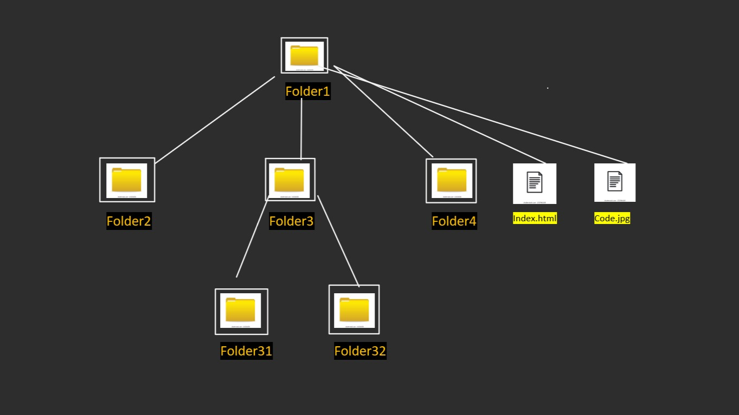
Relative path :
The folder system in a computer is a tree like structure.
In the right side picture let if we are in folder31.
./ : Refers to the same folder (folder31).
../ : refers to the parent folder of the current folder i.e Folder3.
../../ : Grand parent folder of the current folder i.e Folder1 .
../../Folder4 : refers to inside folder4 w.r.t the current folder.
../../index.html : refers to the index.html file inside Folder1.
What is the relative path of code.jpg file when you are in Folder2 ?

Slide 46
HTML paragraph</
Image Tag Example
Exercise
Img src = https://www.cis.upenn.edu/~matuszek/cit594-2012/Pages/backtracking_files/treesearch.gif
Add above image using the url given Also, download the image and add it using relative and absolute path

Slide 47
HTML paragraph</
Image Tag Example
HTML List:
HTML lists allow web developers to group a set of related items in lists.
It consists of two types
1.Ordered List
2.Unordered List

Slide 48
HTML paragraph</
Image Tag Example
HTML Unordered List
An unordered list starts with the <ul> tag. Each list item starts with the <li> tag . The list items will be marked with bullets (small black circles) by default:
Value Description
disc Sets the list item marker to a bullet (default)
circle Sets the list item marker to a circle
square Sets the list item marker to a square
none The list items will not be marked
Value | Description
disc | Sets the list item marker to a bullet (default)
circle | Sets the list item marker to a circle
square | Sets the list item marker to a square
none | The list items will not be marked

Slide 49
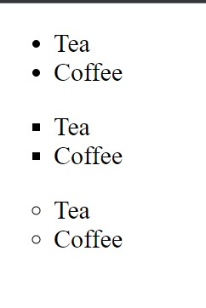
HTML paragraph</
Image Tag Example
Unordered List:
<!DOCTYPE html>
<html>
<head>
<meta charset="UTF-8">
<title>Aravind</title>
</head>
<body>
<ul type="disc"> <!-- default -->
<li>Tea</li>
<li>Coffee</li>
</ul>
<ul type="square">
<li>Tea</li>
<li>Coffee</li>
</ul>
<ul type="circle">
<li>Tea</li>
<li>Coffee</li>
</ul>
</body>
</html>

Slide 50
HTML paragraph</
Image Tag Example
HTML Ordered Lists
An ordered list starts with the <ol> tag. Each list item starts with the <li> tag.
The list items will be marked with numbers by default:
ordered list types
Type Description
type="1" The list items will be numbered with numbers (default).
type="A" The list items will be numbered with uppercase letters.
type="a" The list items will be numbered with lowercase letters.
type="I" The list items will be numbered with uppercase roman numbers.
type="i" The list items will be numbered with lowercase roman numbers.

Slide 51
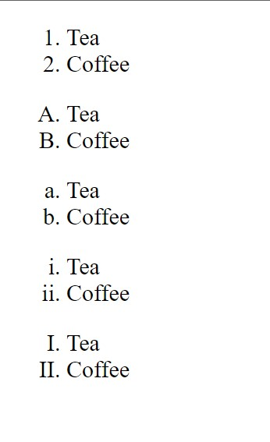
Ordered List :
<!DOCTYPE html>
<html>
<head>
<meta charset="UTF-8">
<title>Aravind</title>
</head>
<body>
<ol type="1"> <!-- default -->
<li>Tea</li>
<li>Coffee</li>
</ol>
<ol type="A">
<li>Tea</li>
<li>Coffee</li>
</ol>
<ol type="a">
<li>Tea</li>
<li>Coffee</li>
</ol>
<ol type="i">
<li>Tea</li>
<li>Coffee</li>
</ol>
<ol type="I">
<li>Tea</li>
<li>Coffee</li>
</ol>
</body>
</html>

Slide 52
HTML paragraph</
Image Tag Example
Exercise
→ Create a nested ordered list
→ Create an ordered list in reverse order 3,2,1

Slide 53
HTML paragraph</
Image Tag Example
HTML Forms:
An HTML form is used to collect user input. The user input is most often sent to a server for processing .
The <form> tag is a container for different types of input elements, such as: text fields, checkboxes, radio buttons, submit buttons, etc.
→ The HTML <input> tag is the most used form element.
An <input> element can be displayed in many ways, using the type attribute.
Ex: <input type="number">
ype="i" The list items will be numbered with lowercase roman numbers

Slide 54
HTML paragraph</
Image Tag Example
HTML Forms
The HTML <input> element is the most used form element.
An <input> element can be displayed in many ways, depending on the type attribute
An <input> element can be displayed in many ways, depending on the type attribute.
Type | Description
<input type="text"> | Displays a single-line text input field
<input type="radio"> | Displays a radio button (for selecting one of many choices)
<input type="checkbox"> | Displays a checkbox (for selecting zero or more of many choices)
<input type="submit"> | Displays a submit button (for submitting the form)
<input type="button"> | Displays a clickable button
ype="i" The list items will be numbered with lowercase roman numbers

Slide 55

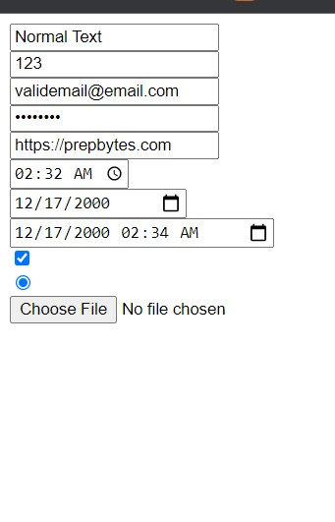
Input Tag:
HTML paragraph</
Image Tag Example
type attribute is mandatory for an input tag.
The default value of type attribute is text.
<input type="text"><br>
<input type="number"><br>
<input type="email"><br>
<input type="password"><br>
<input type="url"><br>
<input type="time"><br>
<input type="date"><br>
<input type="datetime-local"><br>
<input type="checkbox"><br>
<input type="radio"><br>
<input type="file"><br>

Slide 56
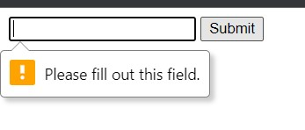
HTML paragraph</
Image Tag Example
HTML Form Required Attribute
→ The required attribute is a boolean attribute.
→ When present, it specifies that an input field must be filled out before submitting the form.
Ex:
<form>
<input type="text" required>
<input type="submit" >
</form>

Slide 57
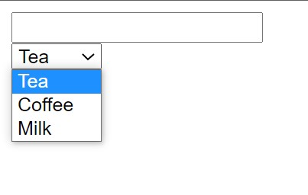
HTML paragraph</
Image Tag Example
HTML Form Dropdown
Dropdown is used to select the options from the list which is having in the dropdown box
The <select> element is used to create a drop-down list.
The <select> element is most often used in a form, to collect user input.
The name attribute is needed to reference the form data after the form is submitted (if you omit the name attribute, no data from the drop-down list will be submitted).
<form>
<input type="text" name="username"><br>
<select name="dropdown">
<option value="Tea">Tea</option>
<option value="Coffee">Coffee</option>
<option value="milk">Milk</option>
</select>
</form>
The <option> tags inside the <select> element define the available options in the drop-down list.

Slide 58
HTML paragraph</
Image Tag Example
Exercise
Replicate HTML of signup form on prepbytes website
https://www.prepbytes.com/register

Slide 59
Video Tag:
HTML <video> tag is used to embed a video content in the webpage.
<video> tag is much like <img> tag.
There are three supported video formats in HTML : MP4 , WebM , OGG .
The Video tag contains one or more <source> tags with different video sources . The browser will choose the first source it supports .

Slide 60
Optional Attributes For Video tag:
Autoplay (Boolean) : As soon as the video is ready it plays automatically .
Controls (Boolean) : Enables controls of the video .
Height(in pixels) : Specifies the height of the video player.
Width(in pixels) : specifies the width of the video player.
Loop (Boolean) : Video will start over again , every time it’s finished.
Muted (Boolean) : Specifies the audio of the video should be muted .
Src(source) : Specifies the URL/Address of the video file.
Note : The autoplay attribute doesn’t work when the video is unmuted .

Slide 61
Iframes:
An inline frame(iframe) is used to embed another web page with in the current HTML document .
Syntax:
<iframe src=“url” ></iframe>
→ <iframe
src="./index.html"
width="300"
height="300"
>
</iframe>

Slide 62
Favicon :
A favicon is a small image displayed before title of the webpage .
We can add favicon to our webpage by using <link> tag .
Ex:
<link rel="icon" href="./image.ico">

Slide 63
HTML paragraph</
Image Tag Example
HTML Tables
→ HTML tables allow web developers to arrange data into rows and columns.
Each table cell is defined by a <td> and a </td> tag.td stands for table data.
Each table row starts with a <tr> and end with a </tr> tag.tr stands for table row.
You can have as many rows as you like in a table, just make sure that the number of cells are the same in each row.
To make a cell span over multiple columns, use the colspan attribute . To make a cell span over multiple rows, use the rowspan attribute:

Slide 64
HTML Table :
<table> : Defines HTML table.
<caption> : Defines the title of the table.
<tr>(table row) : defines a table row .
<th>(table header): Defines the header cell
<td>(table data) : Defines a table’s cell .
<colgroup> :Specifies a group of one or more columns in a table for formatting.
<col> : Specifies column properties for each column inside <colgroup> .
<thead> : Groups the header content in a table ..
<tbody> : groups the body content in a table.
<tfoot> : Groups the footer content in a table .

Slide 65
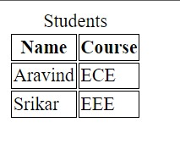
HTML paragraph</
Image Tag Example
HTML Table::
<table>
<caption>Students</caption>
<thead>
<tr>
<th>Name</th>
<th>Course</th>
</tr>
</thead>
<tbody>
<tr>
<td>Aravind</td>
<td>ECE</td>
</tr>
<tr>
<td>Srikar</td>
<td>EEE</td>
</tr>
</tbody>
</table>

Slide 66
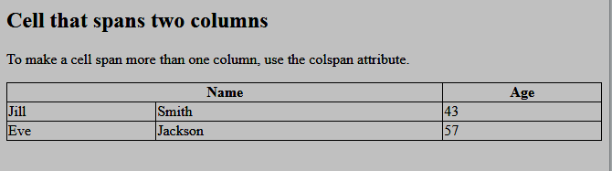
HTML paragraph</
Html Table Colspan Output
1
2
From Above Arrows indicated you can observe that Name occupies the two columns

Slide 67
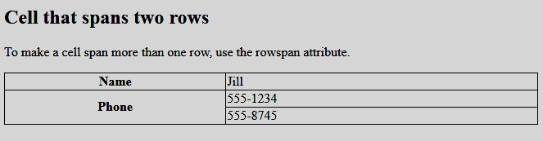
HTML paragraph</
Html Table Colrow
As you can see above Phone Occupies two rows

Slide 68
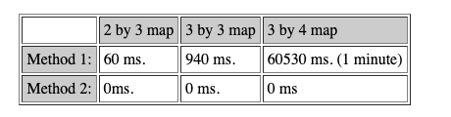
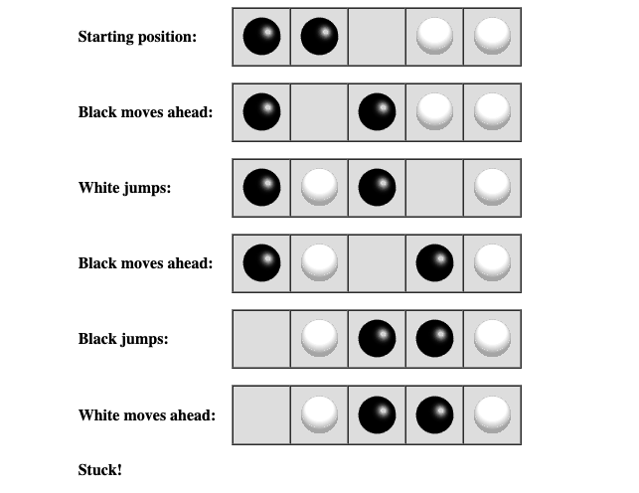
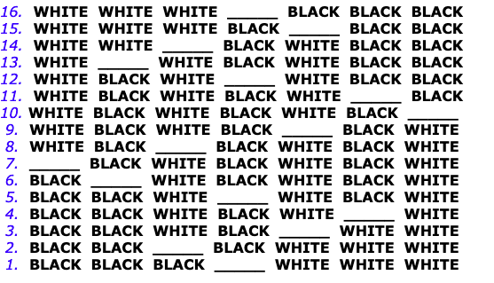
HTML paragraph</
Exercise – Replicate the three forms given below

Slide 69
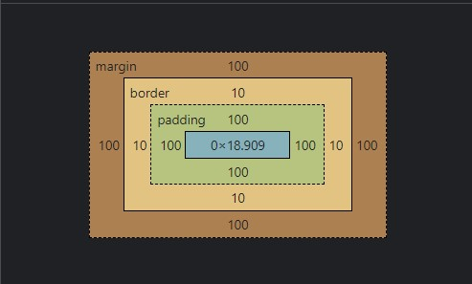
HTML paragraph</
Image Tag Example
CSS Box model :
<!DOCTYPE html>
<html>
<head>
<title>Test</title>
<style>
b{
padding:100px;
border:10px solid rgb(255, 191, 191);
background-color: rgb(240, 240, 178);
margin:100px;
}
</style>
</head>
<body>
<b>Text</b>
</body>
</html>

Slide 70
HTML paragraph</
Block vs Inline :

Slide 71
HTML paragraph</
Image Tag Example
Section :
Section tag defines the section documents such as headers, footers or any other sections .
The section tag is used when requirements of two headers or footers or any other section of documents needed.
The main advantage of the section tag is, it is a semantic element, which describes its meaning to both browser and developer.
<section>Section Contents</section>

Slide 72
HTML paragraph</
Image Tag Example
Nav :
The <nav> tag defines the navigation menu .
<nav> tag is intended only for major block navigation links .
<nav>
<a href="https://google.com">Google</a>
<a href="https://amazon.com">Amazon</a>
<a href="https:// contact">Contact US</a>
</nav>

Slide 73
HTML paragraph</
Image Tag Example
Header :
The <header> tag represents a container for introductory contents or a set of navigation links .
You can have several header elements in a single HTML document .However <header> tag can’t be placed in <footer> tag or another <header> element .
→
<header>
<h1>C++ Tutorial</h1>
<img src="./image.jpg">
<p>This is the Page header</p>
</header>

Slide 74

HTML paragraph</
Image Tag Example
Footer :
The <footer> tag defines a footer for a document or section .
A <footer> element typically contains :
→ Authorship Information .
→ Copyright information .
→ contact information .
→ Sitemap .
→ Back to top links .
→ Related documents .

Slide 75
Command Line Interface :
mkdir – creates a new directory/folder .
C:\Users\Aravind>mkdir test
Rmdir – Removes the directory.
C:\Users\Aravind>rmdir test
dir – used for lookup of all directories and files.
Cd – Navigating from directory to directory .
notepad – Used to create a new file .
C:\Users\Aravind>notepad temp.html
del /f – To delete an existing file .
C:\Users\Aravind>del /f temp.html

Slide 76
Git Commands:
git init – Intialises a new repository in your current working directory. (.git folder).
git status – shows the status of local repository .
git add – Adding one/more files and folders to the local git repository .
git add ‘file1’ ‘file2’ folder1 folder2.
git commit –m “message” – Used to save changes.
git remote add origin “remote_git_repo_url” – Linking the local git repository with remote git repository .
git push –u origin master - pushes the files from local git repository to the linked remote git repository .

